Slide 1
GIT 101
February 2020

Slide 2
Agenda
Git Fundamentals
Practicing Git
Git & Visual Studio in Quantum
Some Git Tips
Q & A

Slide 3
Git Fundamentals

Slide 4
What is GIT?
Source control toolkit
Directory content management system
Tree history storage system
Content Tracker
Toolkit
Via the Command line

Slide 5
What is GIT?
Git is NOT
SubVersion (svn)
Good ol’ TFS/VSTS
Not even a plug-in
The next gen of version control

Slide 6
Centralized Version Control
Version Control Server
Computer A
Version Database
File
Version 3
Version 2
Computer B
Version 1
File

Slide 7
Distributed Version Control
Version Control Server
Clone
Version Database
Version 3
Computer A
Version 2
Computer B
File
File
Version 1
Version Database
Version Database
Version 3
Version 3
Version 2
Version 2
Version 1
Version 1

Slide 8
Distributed Version Control
Each copy of the codebase is considered a clone
To obtain a copy of the codebase you clone the repo
Disconnected mode
Operation scope is local
Version database is local
Network not needed (until fetching/pushing)

Slide 9
Distributed Version Control
'Disconnected Mode’
Make changes to a file (git commit)
View the history of the file or repo (git log)
Load previous versions/commits (git show HEAD)
The status of your repo (git status)
Compare files or tree changed not yet staged (git diff)
Branch switching (git checkout)
Branch updates and synchronization (git merge)

Slide 10
How GIT works?
Customary to understand
Git vs other version control tools
Key concept: File-based Delta Storage vs Checksum (SHA-1) Generation

Slide 11
File-based Delta Storage
MyProgram.csproj
Program.cs
Program1.cs
<Project Sdk="Microsoft.NET.Sdk">
<PropertyGroup>
<OutputType>Exe</OutputType>
<TargetFramework>
netcoreapp3.1
</TargetFramework>
</PropertyGroup> </Project>
using System;
namespace MyProgram
{
class Program
{
static void Main(string[] args)
{
Console.WriteLine("Hello World from C#!");
}
}
}
using System;
namespace MyProgram
{
class Program1
{
...
}
}
using System;
namespace MyProgram
{
class Program
{
static void Main(string[] args)
{
Console.WriteLine("Hello World!");
}
}
}
Commit
A
Commit
B
Commit
C
Commit
D
<Project Sdk="Microsoft.NET.Sdk">
<PropertyGroup>
<OutputType>Exe</OutputType>
<TargetFramework>
netcoreapp3.1
</TargetFramework>
</PropertyGroup> </Project>
- Program1.cs
+ Program.cs
MyProgram.csproj
...
Console.WriteLine("Hello World!”);
...
- Console.WriteLine("Hello World!");
+ Console.WriteLine("Hello World from C#!");
Program.cs
(copy)
Program1.cs
(rename)

Slide 12
Checksum (SHA-1) generation
MyProgram.csproj
Program.cs
Program1.cs
<Project Sdk="Microsoft.NET.Sdk">
<PropertyGroup>
<OutputType>Exe</OutputType>
<TargetFramework>
netcoreapp3.1
</TargetFramework>
</PropertyGroup> </Project>
using System;
namespace MyProgram
{
class Program
{
static void Main(string[] args)
{
Console.WriteLine("Hello World from C#!");
}
}
}
using System;
namespace MyProgram
{
class Program1
{
...
}
}
using System;
namespace MyProgram
{
class Program
{
static void Main(string[] args)
{
Console.WriteLine("Hello World!");
}
}
}
Commit
A
Commit
B
Commit
C
Commit
D
checksum
(SHA-1)
d9c MyProgram.csproj
ca7 Program.cs
d9c MyProgram.csproj
b76 Program.cs
d9c MyProgram.csproj
b76 Program.cs
d9c MyProgram.csproj
b76 Program.cs
b76 Program1.cs
d9c
ca7
b76
b76
+ Hello World!
- Hello World!
+ Hello World from C#!
using System;
namespace MyProgram
{
class Program1
{
...
}
}

Slide 13
Git Identity
git config --global --list
git config --global user.name 'Your name'
git config --global user.email 'your@email.com'

Slide 14
Git internals
Git directory
.git
Repo files
Config file
Branches
Object database
Logs
Head
Info
Hooks
Index
References

Slide 15
Git internals
Git directory
.git
Repo files
ls .git/
Config file
Branches
Object database
Logs
Head
Info
Hooks
Index
References

Slide 16
Git internals
Core parts of Git
HEAD is a special pointer that tells the current branch
Index is where the staging area information is located
Objects is the directory that stores all the content of the Git DB
Refs stores all different pointers for
Branches
Remotes
Tags

Slide 17
Git internals
More about the objects directory
Blob
Tree (Posix dir)
Commit (pointer)
Tag (pointer)
Key-value data store
Immutable

Slide 18
Git internals
More about the objects directory
Blob
Tree (Posix dir)
Commit (pointer)
Tag (pointer)
Key-value data store
Immutable
git cat-file –p origin^{tree}
git cat-file –p <filename>
find .git/objects –type f
cat .git/config
git verify-pack -v

Slide 19
Git Integrity
Everything in Git is check-summed, stored and referred by SHA-1 hash
40-character string hexadecimal
Short and long format
echo 'hi' | git hash-object --stdin
commit d9cbc554d52d7b04a7fef78f8c028c751b0b84fb
Merge: 0bb8a476d7 6e313c9d41
Author: Jing He <Jing.He@me.com>
Date: Sat Feb 22 01:25:21 2020 +0000
Initial commit

Slide 20
Git: the 3 states
Committed
Data is safely stored in the Git database
Modified
A file has changed but not committed to the database yet
Staged
A modified file has been marked to go into the next snapshot

Slide 21
Practicing Git

Slide 22
Walking the tree: Branching and Merging
HEAD
git init
git add <filename>
git commit –m ‘my comment’
...
develop
C0

Slide 23
Walking the tree: Branching and Merging
HEAD
git add <file>
git commit ...
develop
C0
C1

Slide 24
Walking the tree: Branching and Merging
develop
git checkout –b PBI#1234
C0
C1
PBI#1234
HEAD

Slide 25
Walking the tree: Branching and Merging
develop
git commit ...
C0
C1
C2
PBI#1234
HEAD

Slide 26
Walking the tree: Branching and Merging
develop
git commit
git commit
C0
C1
C2
C3
PBI#1234
HEAD

Slide 27
Walking the tree: Branching and Merging
HEAD
git checkout develop
develop
C0
C1
C2
C3
PBI#1234

Slide 28
Walking the tree: Branching and Merging
git commit
HEAD
develop
C0
C1
C4
C2
C3
PBI#1234

Slide 29
Walking the tree: Branching and Merging
git commit
git commit
HEAD
develop
C0
C1
C4
C5
C2
C3
PBI#1234

Slide 30
Walking the tree: Branching and Merging
git checkout PBI#1234
develop
C0
C1
C4
C5
C2
C3
PBI#1234
HEAD

Slide 31
Walking the tree: Branching and Merging
git checkout PBI#1234
git merge develop
git commit
develop
C0
C1
C4
C5
C2
C3
C6
PBI#1234
HEAD

Slide 32
Git & Visual Studio in Quantum

Slide 33
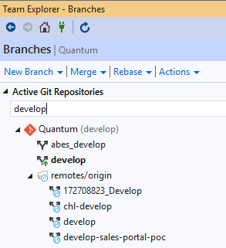
Git & Visual Studio
Identify and learn your branches
Tracked vs Un-tracked

Slide 34
Git & Visual Studio
Identify and learn your branches
Tracked vs Un-tracked

Slide 35
Some Git Tips

Slide 36
Tip: Always fetch and branch, then pull
git fetch ; git branch –vv
git pull
Keeps your local Git DB in sync
Always and before pushing your work!

Slide 37
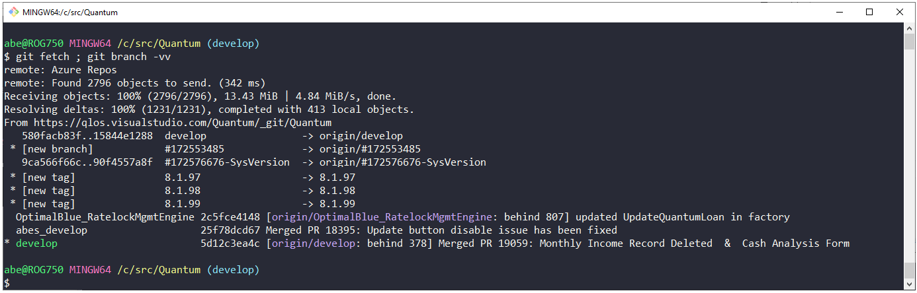
Tip: Always fetch and branch, then pull
git fetch ; git branch –vv
git pull

Slide 38
Tip: Always create a remote-tracking branch
git checkout –b <your_branch> origin/develop
References to the state of a remote branch
Accurately represent the state of the branch
Only move when network communication
Reduces risk of merging at the end
Build master will thank you!

Slide 39
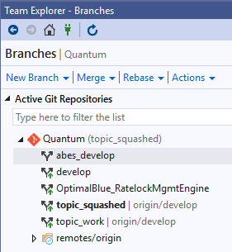
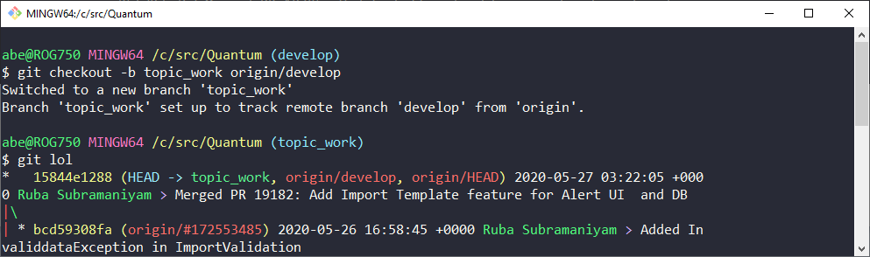
Tip: Always create a remote-tracking branch
git checkout –b <your_branch> origin/develop

Slide 40
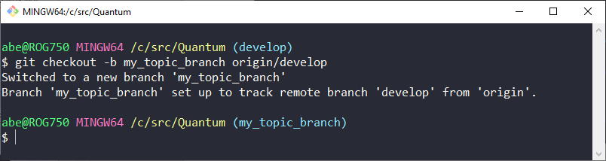
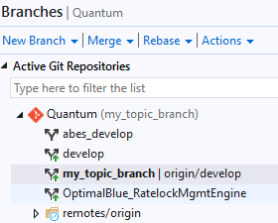
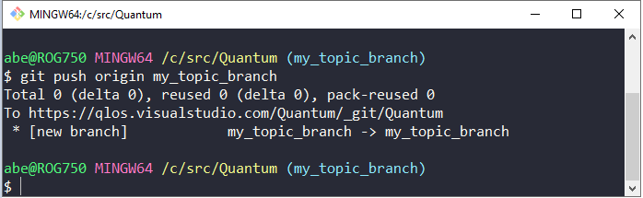
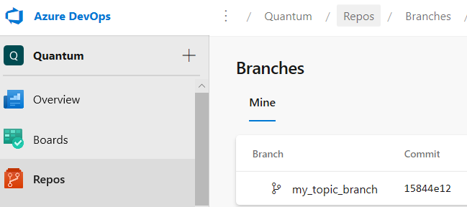
Tip: Always push to a remote topic branch
git checkout –b <your_topic_branch> origin/develop
git push origin <your_topic_branch>

Slide 41
Tip: Squash your commits
git checkout -b <topic_work_branch> <source_stable>
git checkout -b <topic_squashed_branch> <source_stable>
git merge --squash <topic_work_branch>
Check in early & Check in often
Easier to do Code Review

Slide 42
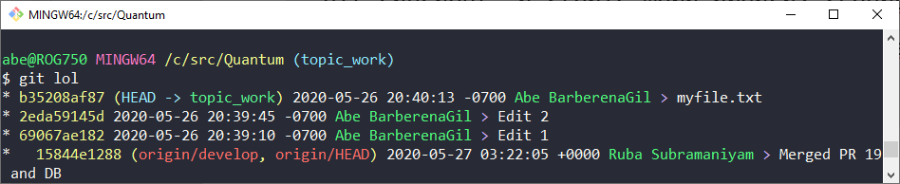
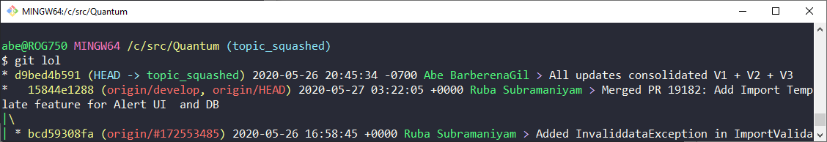
Tip: Squash your commits
git checkout -b <topic_work_branch> <source_stable>
git checkout -b <topic_squashed_branch> <source_stable>
git merge --squash <topic_work_branch>

Slide 43
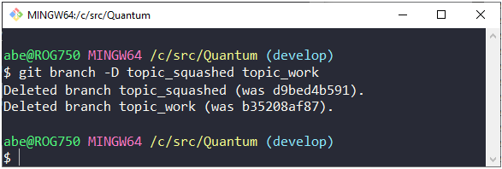
Tip: Always clean after yourself
git branch –D <your_topic_branch>
Only after a submitted & approved PR
Only remove your branches

Slide 44
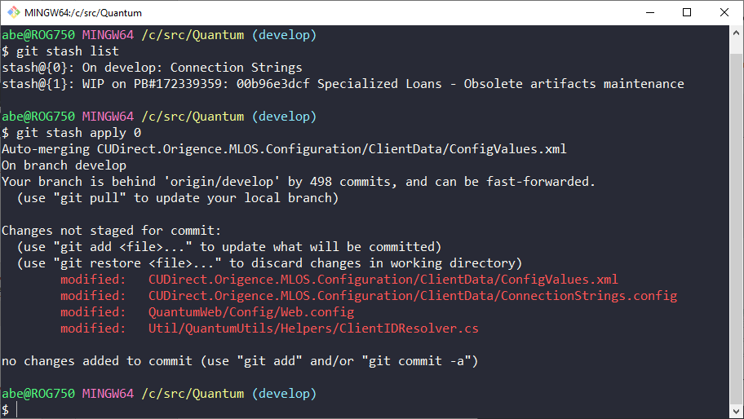
Tip: Keep your mess & don’t commit half-a** work
git status –s
git stash git stash list git stash apply {0}

Slide 45
Tip: Avoid committing unmodified files

Slide 46
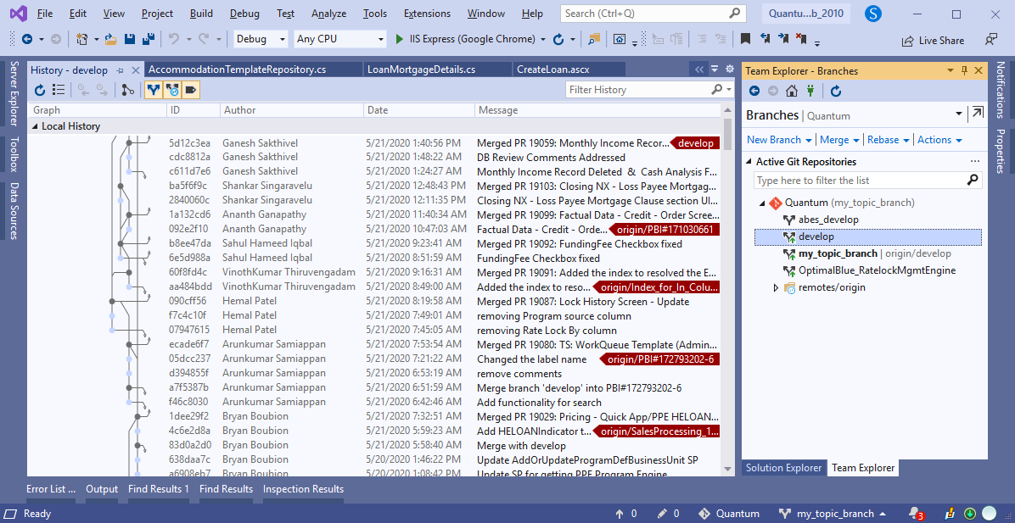
Tip: Improve your understanding of Git in VS

Slide 47
Git
Q & A

